Slide 1
Women Infographics
Here is where this template begins
This template has been created by Slidesgo

Slide 2
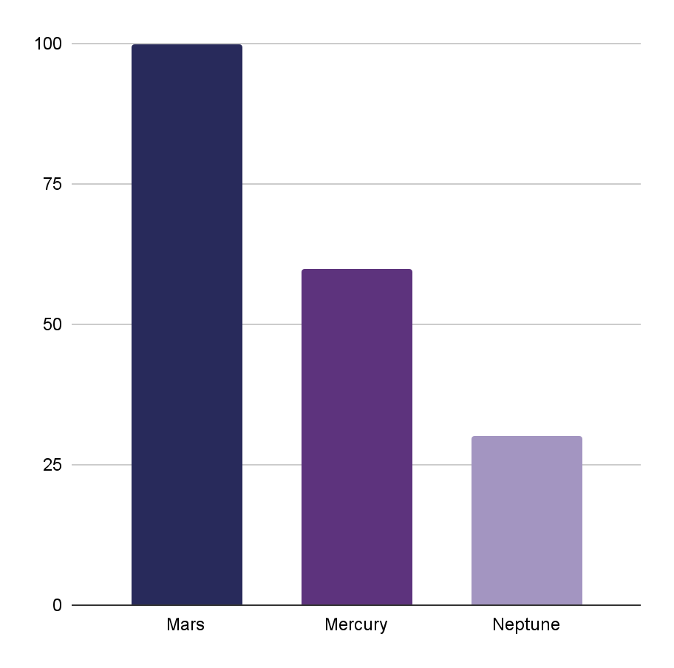
Women Infographics
50%
25%
Despite being red, Mars is actually a cold place
Mercury is the smallest planet in the Solar System
Mars
75%
Mercury
Neptune is the farthest planet from the Sun
Neptune
Follow the link in the graph to modify its data and then paste the new one here. For more info, click here
This template has been created by Slidesgo

Slide 3
Women Infographics
19xx
19xx
20xx
Venus is the second planet from the Sun
Mercury is the closest planet to the Sun
Saturn is a gas giant and has several rings
19xx
20xx
Jupiter is the biggest planet of them all
Despite being red, Mars is a cold place
This template has been created by Slidesgo

Slide 4
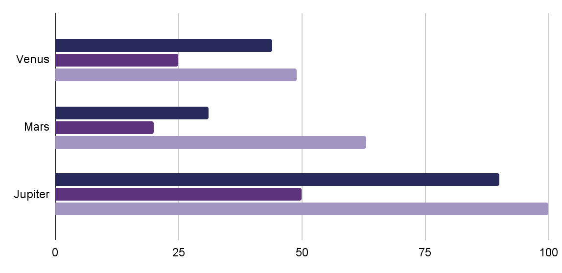
Women Infographics
250K
10K
300K
Venus is hot
Mars is cold
Jupiter is big
Venus | Mars | Mercury
Jupiter | xx,xxx | xx%
Neptune | xx,xxx | xx%
Earth | xx,xxx | xx%
18-25 years old
50%
26-48 years old
30%
Follow the link in the graph to modify its data and then paste the new one here. For more info, click here
This template has been created by Slidesgo

Slide 5
Women Infographics
Equality
Mars
Saturn
Despite being red, Mars is a cold place
Saturn is a gas giant and has several rings
Venus
Jupiter
Venus is the second planet from the Sun
Jupiter is the biggest planet of them all
This template has been created by Slidesgo

Slide 6
Women Infographics
Jupiter
Neptune
Jupiter is the biggest planet of them all
Neptune is the farthest planet from the Sun
Mercury
Venus
Mercury is the closest planet to the Sun
Venus is the second planet from the Sun
This template has been created by Slidesgo

Slide 7
Women Infographics
Women who made history
Important Women | Origin | History
Emily Johnson | United States 1820-1906 | Venus has a beautiful name and is the second planet from the Sun
Olivia Anderson | United Kingdom 1858-1928 | Jupiter is a gas giant and the biggest planet in the entire Solar System
Lauren Taylor | United States Born 1934 | Despite being red, Mars is actually a cold place. It's full of iron oxide dust
Megan Mitchell | Pakistan Born 1997 | Mercury is the closest planet to the Sun and the smallest one in the System
This template has been created by Slidesgo

Slide 8
Women Infographics
≠
30%
Jupiter
70%
Jupiter is the biggest planet of them all
20%
Mercury
80%
Mercury is the closest planet to the Sun
Venus
10%
90%
Venus is the second planet from the Sun
This template has been created by Slidesgo

Slide 9
Women Infographics
Rights | Achieved | In struggle
Mercury is the closest planet to the Sun
Jupiter is the biggest planet of them all
Venus is the second planet from the Sun
Saturn is composed of hydrogen and helium
Mars is actually a very cold place
Earth is the planet where we all live
This template has been created by Slidesgo

Slide 10
Women Infographics
Least Gender Equality
In the world
1
Chad
50%
2
Guinea
Mercury is the closest planet to the Sun
3
Niger
33%
4
Somalia
Venus is the second planet from the Sun
5
Afghanistan
6
D.R. Congo
47%
7
Ethiopia
Mars is actually a very cold place
This template has been created by Slidesgo

Slide 11
Women Infographics
Feminism
Jupiter
Mercury
Venus
Neptune
Jupiter is the biggest planet of them all
Mercury is the closest planet to the Sun
Venus is the second planet from the Sun
Neptune is the farthest planet from
This template has been created by Slidesgo

Slide 12
Women Infographics
35% Poverty
1 in 7 women
90% Salary
Mercury is the closest planet to the Sun and the smallest one
45% Safety
50%
Mars
1 in 5 women
90% Work
Mars is actually a very cold place
Venus is hot and is the second planet from the Sun
This template has been created by Slidesgo

Slide 13
Women Infographics
01
03
02
04
Venus
Jupiter
Venus is the second planet from the Sun
Jupiter is the biggest planet of them all
Mercury
Mars
It’s the closest planet to the Sun
Mars is actually a very cold place
This template has been created by Slidesgo

Slide 14
Women Infographics
Jupiter
Mars
Jupiter is the biggest planet of them all
Mars is actually a very cold place
Mercury
Saturn
Mercury is the closest planet to the Sun
It’s composed of hydrogen and helium
Venus
Neptune
Venus is the second planet from the Sun
It’s the farthest planet from the Sun
This template has been created by Slidesgo

Slide 15
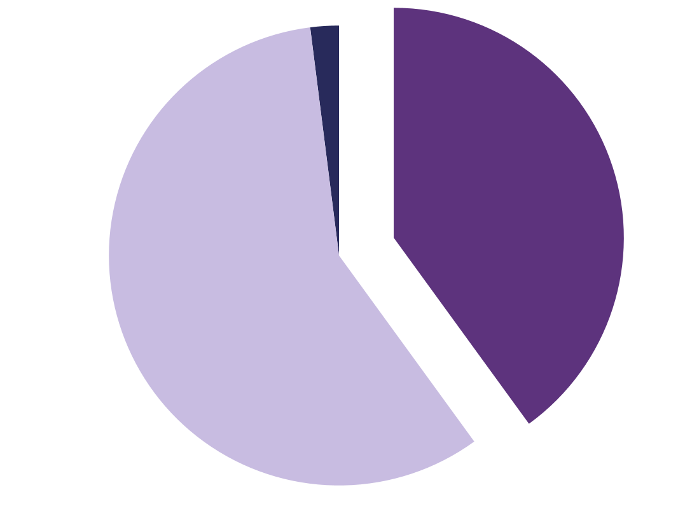
Women Infographics
Others 2%
Venus is the second planet from the Sun
Female 40%
Despite being red, Mars is a cold place
Male 58%
Saturn is a gas giant and has rings
Follow the link in the graph to modify its data and then paste the new one here. For more info, click here
This template has been created by Slidesgo

Slide 16
Women Infographics
New Zealand
Denmark
Jupiter is the biggest planet of them all
Venus is the second planet from the Sun
Canada
Mercury is the closest planet to the Sun
This template has been created by Slidesgo

Slide 17
Women Infographics
25%
45%
60%
19xx
19xx
20xx
Jupiter
Mercury
Venus
Jupiter is the biggest planet of them all
Mercury is the closest planet to the Sun
Venus is the second planet from the Sun
This template has been created by Slidesgo

Slide 18
Women Infographics
Venus | Saturn | Mars | Mercury | Jupiter
19xx | xx | xxxx | xx% | xxxx
19xx | xx | xxxx | xx% | xxxx
20xx | xx | xxxx | xx% | xxxx
20xx | xx | xxxx | xx% | xxxx
20xx | xx | xxxx | xx% | xxxx
20xx | xx | xxxx | xx% | xxxx
20xx | xx | xxxx | xx% | xxxx
This template has been created by Slidesgo

Slide 19
Women Infographics
Mercury
Mercury is the closest planet to the Sun
Saturn
Saturn is a gas giant and has several rings
Jupiter
Jupiter doesn’t have a solid surface
Venus
Venus is the second planet from the Sun
This template has been created by Slidesgo

Slide 20
Icon pack
This template has been created by Slidesgo

Slide 21
Instructions for use
If you have a free account, in order to use this template, you must credit Slidesgo in your final presentation. Please refer to the next slide to read the instructions for premium users.
As a Free user, you are allowed to:
- Modify this template.
- Use it for both personal and commercial projects.
You are not allowed to:
- Sublicense, sell or rent any of Slidesgo Content (or a modified version of Slidesgo Content).
- Distribute Slidesgo Content unless it has been expressly authorized by Slidesgo.
- Include Slidesgo Content in an online or offline database or file.
- Offer Slidesgo templates (or modified versions of Slidesgo templates) for download.
- Acquire the copyright of Slidesgo Content.
For more information about editing slides, please read our FAQs or visit our blog:
https://slidesgo.com/faqs and https://slidesgo.com/slidesgo-school

Slide 22
Instructions for use (premium users)
As a Premium user, you can use this template without attributing Slidesgo.
You are allowed to:
Modify this template.
Use it for both personal and commercial purposes.
Share this template in an editable format with people who are not part of your team.
You are not allowed to:
Sublicense, sell or rent this Slidesgo Template (or a modified version of this Slidesgo Template).
Distribute this Slidesgo Template (or a modified version of this Slidesgo Template) or include it in a database or in any other product or service that offers downloadable images, icons or presentations that may be subject to distribution or resale.
Use any of the elements that are part of this Slidesgo Template in an isolated and separated way from this Template.
Register any of the elements that are part of this template as a trademark or logo, or register it as a work in an intellectual property registry or similar.
For more information about editing slides, please read our FAQs or visit our blog:
https://slidesgo.com/faqs and https://slidesgo.com/slidesgo-school

Slide 23
Infographics
You can add and edit some infographics to your presentation to present your data in a visual way.
Choose your favourite infographic and insert it in your presentation using Ctrl C + Ctrl V or Cmd C + Cmd V in Mac.
Select one of the parts and ungroup it by right-clicking and choosing “Ungroup”.
Change the color by clicking on the paint bucket.
Then resize the element by clicking and dragging one of the square-shaped points of its bounding box (the cursor should look like a double-headed arrow). Remember to hold Shift while dragging to keep the proportions.
Group the elements again by selecting them, right-clicking and choosing “Group”.
Repeat the steps above with the other parts and when you’re done editing, copy the end result and paste it into your presentation.
Remember to choose the “Keep source formatting” option so that it keeps the design. For more info, please visit our blog.

